Slide 1
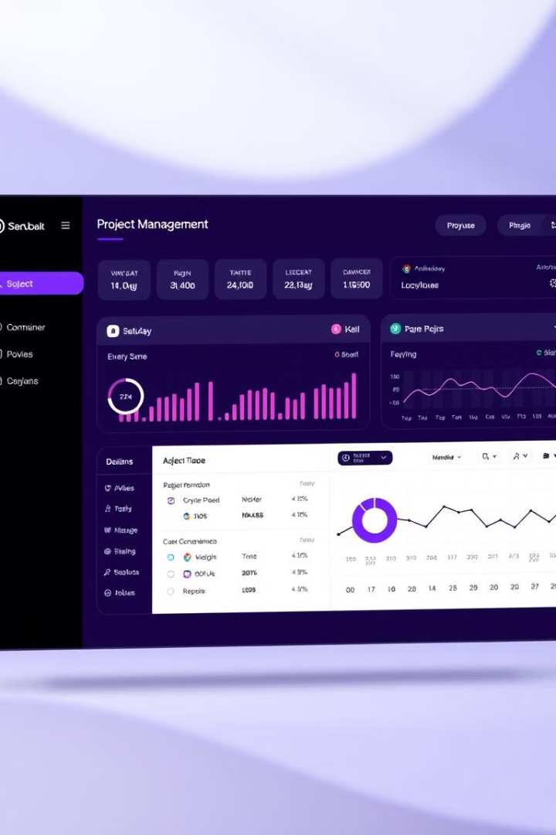
Project Management Dashboard: A Scalable and Secure Solution
This presentation will explore the architecture and key features of our Project Management Dashboard, a web application designed to streamline project management, task tracking, and team collaboration.
Tharun Subramanian C (RA2211003011187) Diveshwar J S (RA2211003011191)

Slide 2
Technology Stack
Frontend
Backend
Next.js
Node.js
Tailwind CSS
Express
Material UI Data Grid
PostgreSQL
Redux Toolkit
Prisma
Redux Toolkit Query

Slide 3
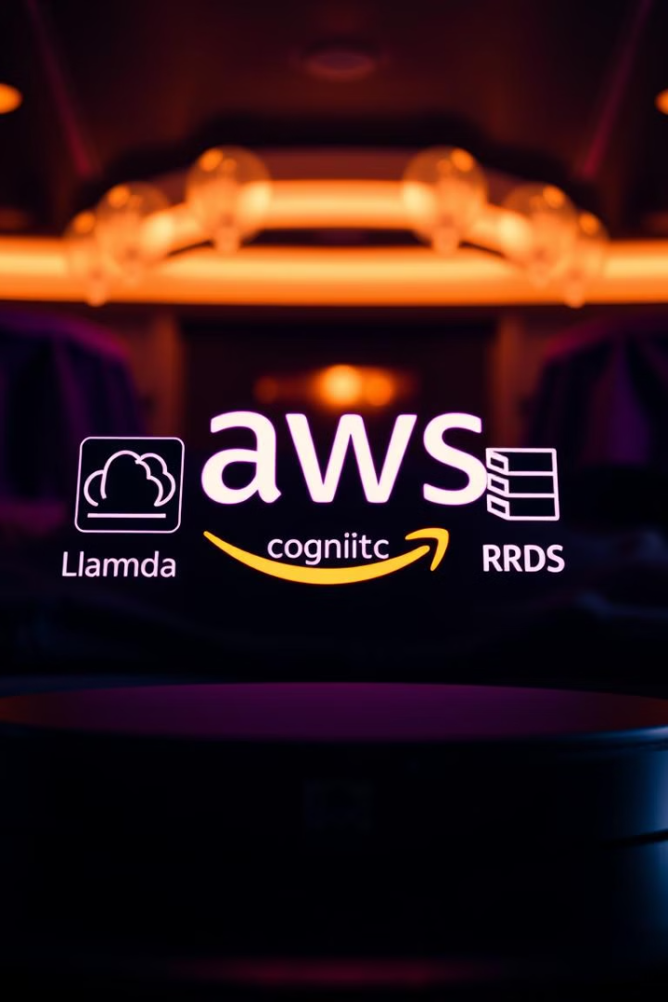
Leveraging AWS Services
1
AWS Lambda
2
AWS Cognito
Serverless backend for processing requests like creating and updating tasks. Automatically scales to handle varying traffic loads, reducing infrastructure costs.
Handles user authentication, allowing secure login and registration, including multi-factor authentication. Integrates with third-party providers like Google or Facebook.
3
AWS RDS
Hosts PostgreSQL database, automating database management tasks like backups, scaling, and patching, ensuring high availability and reliability.

Slide 4
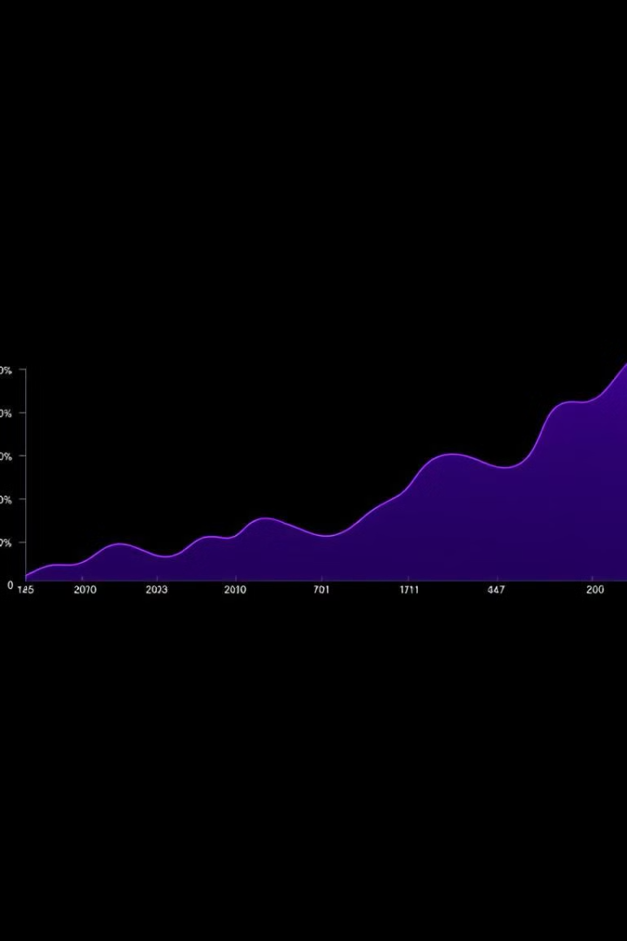
Benefits of AWS Integration
Scalability
Security
AWS services enable the application to scale automatically as user demand grows, ensuring optimal performance and responsiveness.
AWS Cognito provides robust authentication and authorization, safeguarding user data and ensuring secure access to the application.
Cost-Effectiveness
Serverless computing with AWS Lambda reduces server management overhead, while AWS RDS automates database management tasks, minimizing operational costs.

Slide 5
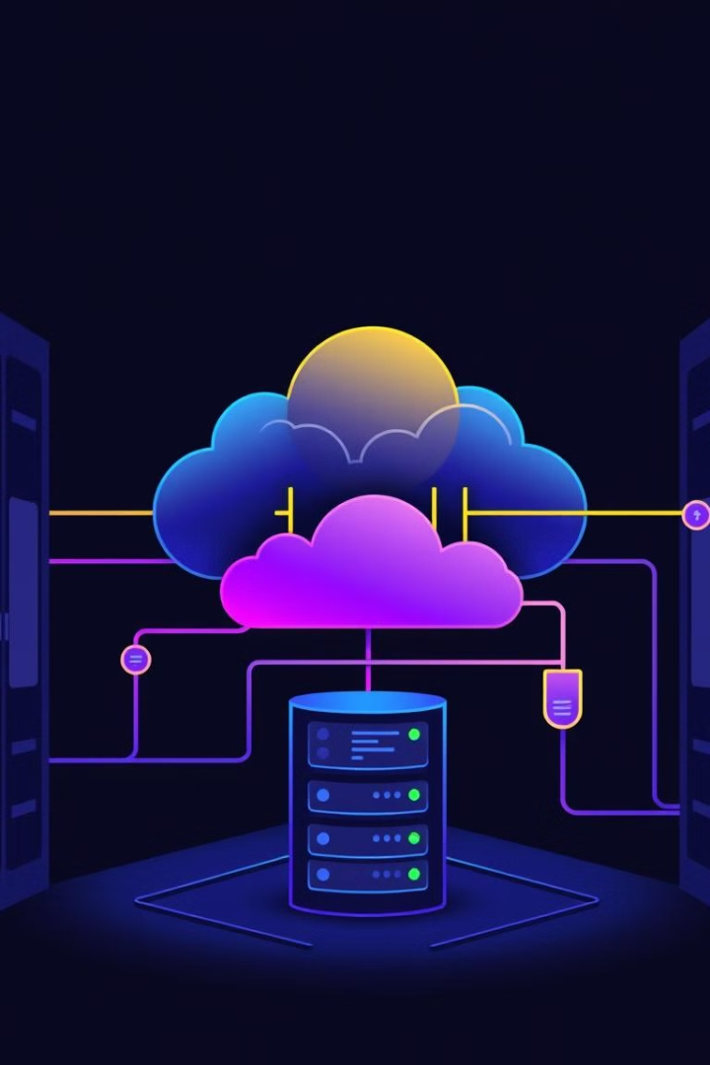



AWS Lambda: Serverless Backend
Serverless Architecture
Scalability
Eliminates the need for server management, allowing the application to focus on core functionality.
Automatically scales to handle varying traffic loads, ensuring optimal performance even during peak usage.
Cost Optimization
Pay-as-you-go pricing model reduces infrastructure costs by only paying for resources used.

Slide 6
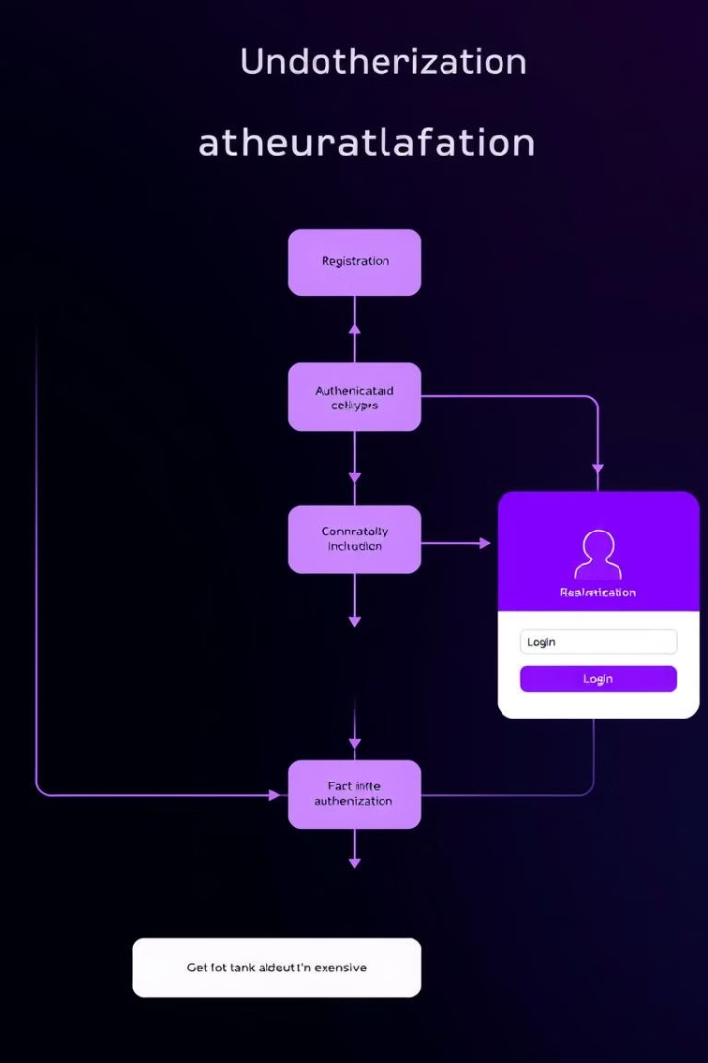
AWS Cognito: Secure User Authentication
1
User Registration
Allows users to create accounts with secure passwords and multi-factor authentication.
2
Login
Provides a secure and convenient login process, supporting social logins with Google or Facebook.
3
Access Control
Manages user permissions and roles, ensuring that only authorized users can access specific data and features.

Slide 7
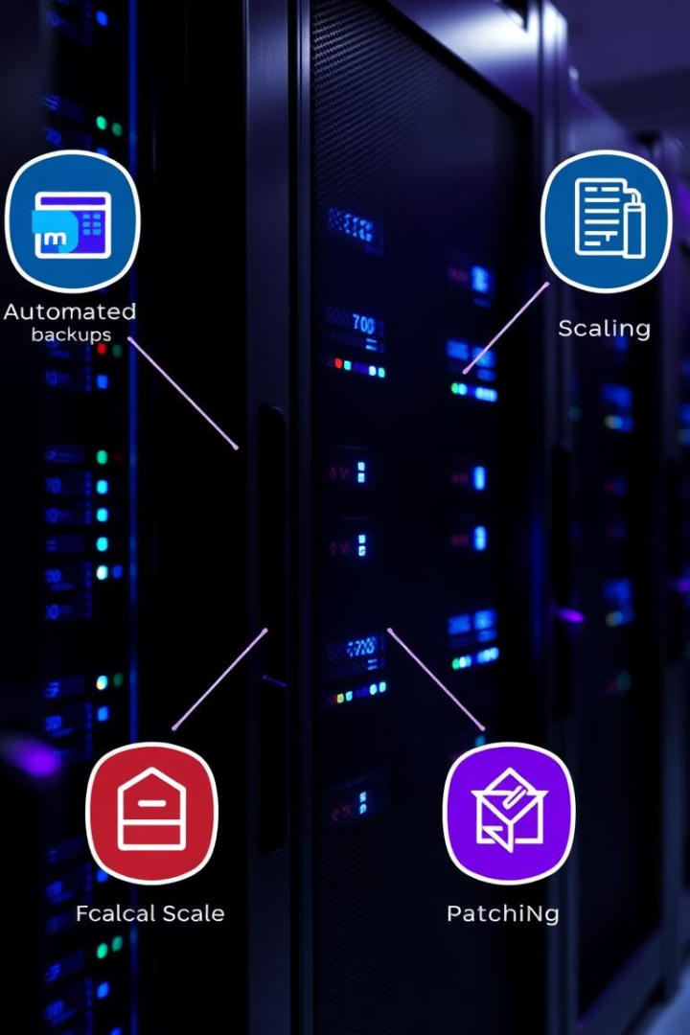



AWS RDS: High-Availability Database
Automated Backups
Regularly creates backups of the database, ensuring data recovery in case of failures.
Scaling
Automatically scales the database to handle varying workloads, ensuring optimal performance under heavy load.
Patching
Applies security patches and updates automatically, minimizing downtime and ensuring database security.

Slide 8




Key Features of the Dashboard
1
Project Management
2
Task Tracking
Assign tasks, set deadlines, and track progress.
3
Team Collaboration
Communicate with team members, share files, and collaborate on tasks.
Reporting and Analytics
4
Generate reports and analyze project data to identify trends and areas for improvement.

Slide 9
Benefits for Users
Increased Productivity
1
Streamlined workflows and efficient task management improve team productivity.
Improved Collaboration
2
Enhanced communication and collaboration tools foster teamwork and streamline project execution.
Enhanced Visibility
3
Real-time project updates and progress tracking provide clear visibility into project status.

Slide 10

Conclusion
1
2
3
Scalable
Secure
Cost-Effective
The dashboard scales automatically to meet the needs of growing teams and projects.
Robust authentication and authorization ensure secure access to sensitive data.
Serverless computing and automated database management minimize operational costs.

